Slide 1
ASSALAMU ALAIKUM
WELCOME TO THE PRESENTATION CEREMONY

Slide 2
Presentation To:
Name : Md Imran Hossain
Assistant Professor
Department of ICT
Comilla university, Comilla.
Presentation By:
Name: Abu Rayhan
ID: 11809029
Session: (2017-2018)
Department of ICT
Comilla University,Comilla

Slide 3
Analog Communication
Tuned Radio Frequency(TRF) Receiver

Slide 4
OUTLINE:
What is tuned radio frequency receiver?
How works it?
Advantage and Disadvantage

Slide 5
What is Tuned Radio Frequency(TRF) Receiver?
A tuned radio frequency receiver (TRF Receiver) is a type of radio receiver that is usually composed of one or more tuned radio frequency amplifier stages followed by a detector (demodulotor) circuit to extract the audio signal and an audio frequency amplifier.
Tuned Radio Frequency Receiver is a simple “logical” receiver

Slide 6
It must also be mentioned that when the Tuned Radio Frequency Receiver was first introduced, it was a great improvement on the types used previously mainly crystal, regenerative and superregenerative receivers

Slide 7
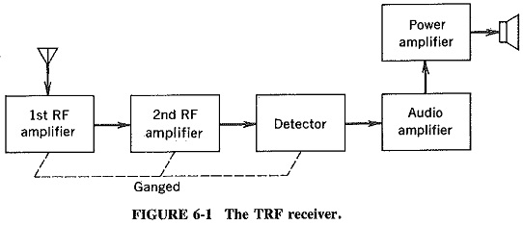
Block Diagram

Slide 8
How to works it?
The classic TRF receivers consisted of three sections.
One or more tuned RF amplifiers stages. These amplify the signal of the desired station to a level sufficient to the drive the detector, while the rejecting all other signals picked up by the antenna.

Slide 9
A detector, which extracts the audio (modulation) signal from the radio carrier signal by rectifying it.
Optionally, but almost always included, one or more audio amplifier stages which increase the power of the audio signal.

Slide 10
Advantage and Disadvantage
Advantage:
They amplify defined frequency.
Signal to noise ratio good.
They are well suited for radio transmitter and receiver.
The band of frequency over which amplification is required can be varied.

Slide 11
Disadvantage:
They are not suitable to amplify audio frequencies.
Since they used inductor and capacitor as tunning the element, the circuit is bulky and costly.
If the band of the frequency is increased, design become complex.

Slide 12
Thank You all

